Slide 1
Syllabus
Unit-IV
WIND ENERGY: Sources and potentials, horizontal and vertical axis windmills, performance characteristics, Betz’s criteria, types of winds, wind data measurement.
BIO-MASS: Principles of bio-conversion, anaerobic/aerobic digestion, types of bio-gas digesters, gas yield, Gasifiers, applications.

Slide 2
UNIT IV
Part-A
Wind energy
Sources of wind energy
Potentials of wind energy
Horizontal axis windmills
Vertical axis windmills
Wind characteristics
Vertical axis windmills
Betz’s criteria
Performance characteristics
Types of winds
Wind data measurement

Slide 3
Wind:
Wind is the natural movement of air or other gases relative to a planet's surface.
Wind is essentially air in motion.
Hence, air has wind energy because air is in motion.
Wind energy:
Wind energy is in-fact an indirect form of solar energy.
A small part of solar radiation reaching the earth is converted into wind energy.
The electrical energy obtained from harnessing the wind with wind mills or wind turbines.

Slide 4
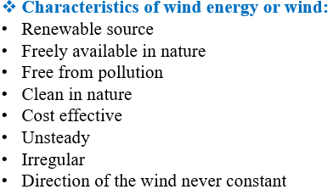
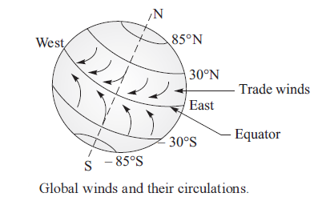
Origin or sources of wind:
Following are the two sources/origins of wind
1)Local winds:
These winds are caused by unequal heating and cooling of ground surfaces and ocean as well as lake surfaces during day and night.
Uneven heating occurs on land surface and water bodies due to solar radiation. As a result, cool and heavy air currents move from water bodies to land surface.
2)Planetary or global winds:
These winds are caused by daily rotation of earth around its polar axis and unequal temperature between polar regions and equatorial regions.

Slide 5
Potentials of wind energy:
Wind energy is one of the fastest-growing renewable energy sources in the world.
Over 1,000 GW (Gigawatts) of installed wind capacity globally (as of recent years).
Countries like China, USA, Germany, and India are top wind energy producers.
In India, greater wind speeds are available in coastal areas of Saurashtra, some regions of central India and west Rajasthan.
In these areas, there would be a possibility of using medium and large size wind mills for the generation of electricity.
In our nation, the enthusiasm for the wind plants was found in the late fifties and mid-sixties.
The wind energy generated annually over land area of earth is about 1.67×10⁵ kWh.
This is through natural phenomena and 10 times of obtained value gives over the entire global region.
Many projects on the wind mill systems for water pumping and for production of electrical power were taken up by many organizers in our country.
Some of the developments were given below,
WP-2 water pumping wind mill by NAL Bangalore
CAZRI wind mill at Jodhpur (Rajasthan)
12PU 500 wind mill at NAL Bangalore
Madurai wind mill at Madurai (Tamil Nadu)
MP-1 soil wind mill at NAL Bangalore

Slide 6
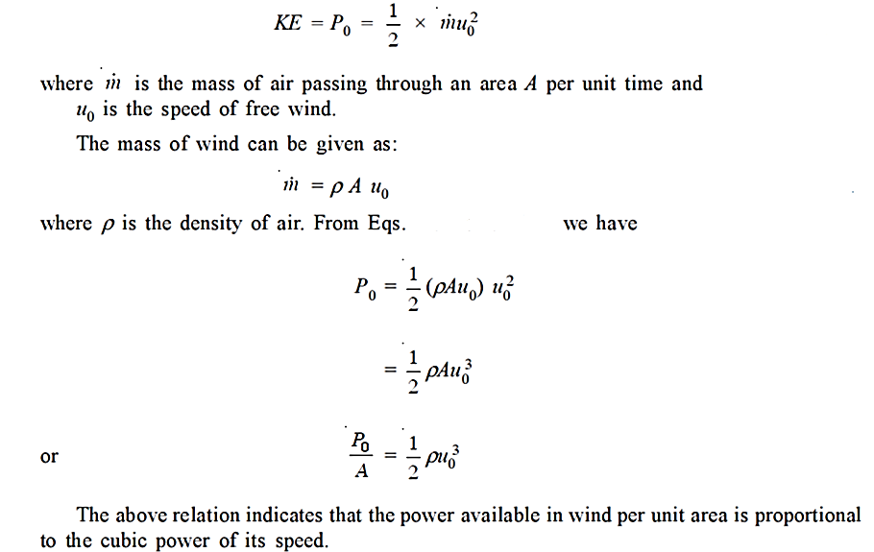
Energy available in wind:
The amount of energy available in the wind at any instant is proportional to cube power of the wind speed.

Slide 7
Wind energy conversion systems:
(or)
Classification of wind mills (wind turbines):
Wind mill is a device which converts the kinetic energy of the wind into the mechanical energy of the turbine shaft.
Wind mill is also called as wind turbine.
Wind energy conversion systems can be classified in many ways.
Their classification depends on various factors which are discussed below,
Classification based on axis of rotation:
Horizontal axis machines:
The axis of rotation of windmill is horizontal and the aero-turbine plane is vertical facing the wind.
Vertical axis machines:
The axis of rotation is vertical.
The sails or blades may also vertical, as on the ancient Persian wind mills or so, as on the modern Darrius rotor machine.

Slide 8
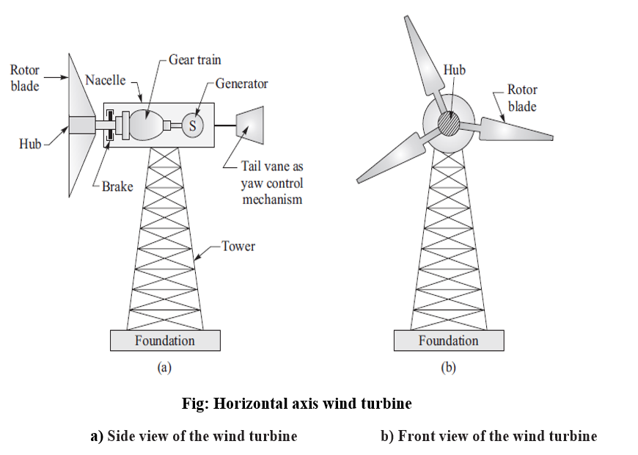
Horizontal axis wind turbine:
or
Construction of horizontal axis wind turbine:
The constructional details of a three-bladed, horizontal axis wind turbine are shown in figure.
The components or main subsystems include:
Turbine blades
Rotor
Hub
Nacelle
Yaw control mechanism
Generator
Tower

Slide 9
Turbine blades:
Turbine blades have aerofoil type cross section to extract energy from wind.
These blades are made of high-density materials such as wood, glass fibre and epoxy composites.
Most of wind turbines have two- or three- blades similar to the propeller of an old aeroplane, but blades of a wind turbine rotate very slowly compared to that of an aeroplane.
A two-bladed rotors give much smoother power output compared to three-bladed rotors.
A three-bladed rotor generates little more power output (more than 5%).
Rotor:
The wind turbine extracts energy from the wind streams by transforming the kinetic energy of the wind into the rotational motion of the rotor of the wind turbine.
Hub:
The central solid portion of a rotor is called hub.
It helps in the attachment of all blades and the incorporation of pitch angle control mechanism.
Nacelle:
The rotor is attached to nacelle which is mounted at the top of a tower.
It houses gearbox, generator, controls and brakes.

Slide 10
Yaw control system:
The yaw control system is provided to adjust the nacelle around the vertical axis so that rotor blades are always facing the wind stream.
Generators (or) electrical systems:
The wind turbines are provided with induction generators to convert mechanical energy into electrical energy.
Tower
Tower is provided to support nacelle and rotor.
The tower height should be sufficient so that enough wind speed can be intercepted by the rotor.
Tower can be made of materials such as steel or concrete.
Working principle of horizontal axis wind mill (HAWM):
It is a wind turbine in which the axis of the rotor's rotation is parallel to the wind stream and the ground.
It is built with a propeller type rotor on a horizontal axis i.e, a horizontal main shaft.
It may be two (or) three bladed (or) more blades.
The rotor converts linear motion of the wind into rotational energy that is used to drive a generator.

Slide 11
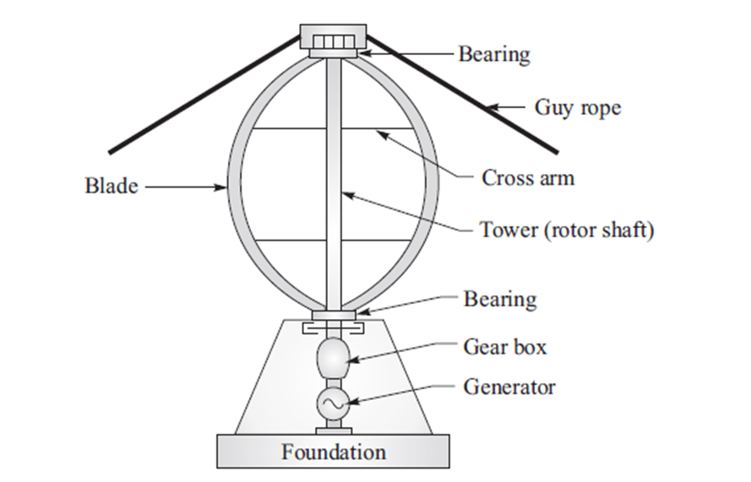
Vertical axis wind turbine (VAWT):
(or)
Construction of vertical axis wind turbine (VAWT):
A VAWT (Darrieus) with all its components is shown in figure.
The components and subsystems include
Tower (rotor shaft)
Blades
Support structure
Generator
Tower (rotor shaft):
The tower consists of a hollow vertical shaft which can rotate about its vertical axis between its bearings at top and bottom.
It is provided with a support structure at the bottom and at the upper end, it is supported by guy ropes.
The height of the tower is about l00 m.
The wind turbine extracts energy from the wind streams by transforming the kinetic energy of the wind into the rotational motion of the rotor of the wind turbine.
Blades:
The wind turbine has two or three blades which are thin and curved shaped similar to an “eggbeater”.
The blades are designed in such a way that they offer aerofoil type cross section to wind stream.
The height of blade is kept 94 m, diameter about 65 m and chord length about 2.4 m.
Fig: Vertical axis wind turbine (VAWT)

Slide 12
Support structure:
It is provided with blades, gearbox and generator to support the weight of tower.
Generators (or) electrical systems:
The wind turbines are provided with induction generators to convert mechanical energy into electrical energy.
Working principle of vertical axis windmills:
Vertical axis wind turbine has the axis of rotation of its rotor perpendicular to the wind stream.
Vertical axis wind turbine is advantageous as
It can accept wind from any direction, thereby eliminating the necessity of any yaw control system.
It can have its gearbox and generator system (nacelle) at the ground level, thereby eliminating the necessity of mounting the heavy nacelle (with gearbox and generator) at the top of the tower.
These features of VAWT also help in the simpler design and installation of the wind turbine, the easier inspection and maintenance of the wind turbine and reducing the overall cost of the wind turbine.

Slide 13
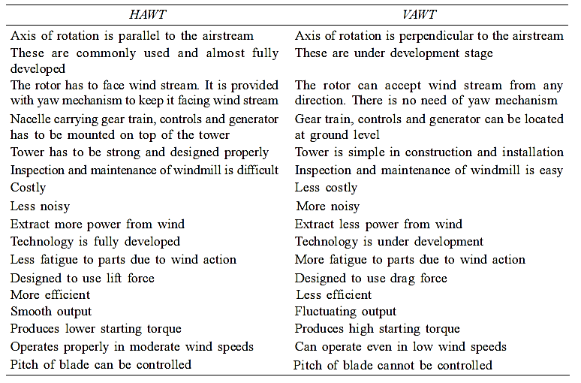
Comparison of HAWT and VAWT:
Table: Comparison of HAWT with VAWT

Slide 14
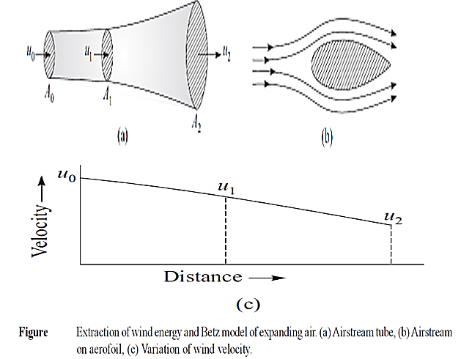
Betz model:
Statement:
The power output of a wind turbine cannot be more than 59.3% of wind energy.
Proof:
The area swept can be considered as airstream tube which is continuously expanding as shown in figure.
This airstream tube model is also called “Betz model” of expanding air.
As air mass flow rate should be the same everywhere within the stream tube according to the “law of continuity”, the wind speed must decrease as air expands.
As shown, airstream tube has area of “A₀” at upstream, area of “A₁” while passing through rotor blade (aerofoil) and area “A₂” downstream.
Consider that u₀ and u₂ are wind velocities at upstream and downstream. The velocity reduction from u₀ to u₂ means that there is a reduction in momentum of the wind as it passes through the wind turbine,

Slide 15
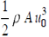
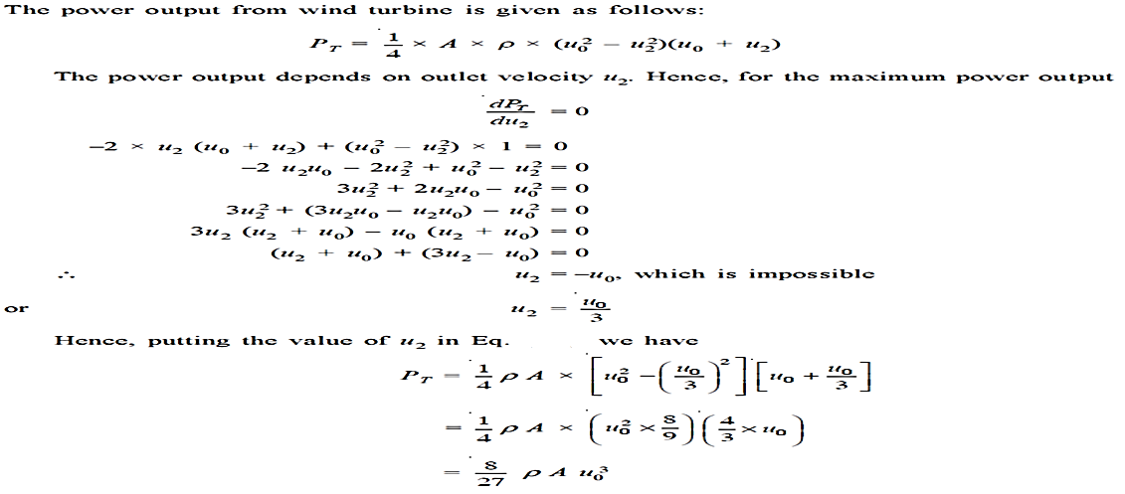
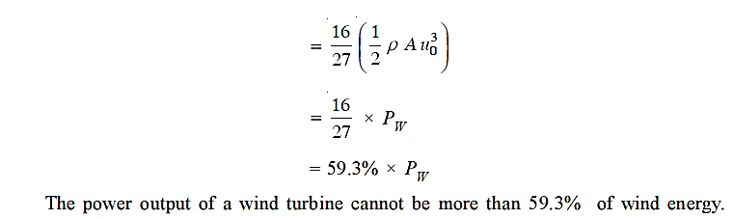
We know that, Energy available in wind Pw =
Also,

Slide 16
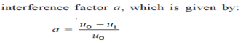
Performance characteristics:
Interference Factor:
An interference factor (a) is defined as a fractional wind speed decrease at the turbine.
An interference factor is a measure of how much the wind speed is reduced as it passes
through the rotor plane of the turbine.
A higher interference factor means a greater reduction in wind speed.
Interference factor is also known as induction factor or perturbation factor.
Power Coefficient:
Power coefficient (C_{p}) is the fraction of available power in the wind that can be extracted.
Simply, the power coefficient indicates the portion or fraction of wind power which can be extracted by the wind turbine.
C_{p}= P_{T}/P_{W}
_{or}
Power coefficient is given as: C_{p}=4a (1-a²)

Slide 17
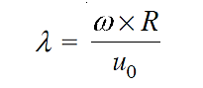
Torque Coefficient:
Torque coefficient (C_{T}) is the ratio of shaft torque (T_{sh}) to the maximum conceivable torque (T_{M}) on the on an ideal turbine rotor.
C_{T=} T_{sh}/T_{M}
The maximum conceivable torque “T_{m}” on the on an ideal turbine rotor would occur if maximum circumferential force acts at the tip of the blade with radius R. Thus,
T_{m} =F×R
Thrust coefficient:
Thrust force is the force acting along the turbine axis.
Thrust coefficient is the ratio of axial thrust force to the maximum thrust force.
C_{F=} F_{a}/F_{Max}
Tip speed ratio (λ):
The tip speed ratio (λ) is defined as the ratio of the speed of tip of the rotor blade to the speed of on-coming air.
Tip speed ratio (λ)= speed of tip of the rotor blade/speed of on-coming air=

Slide 18
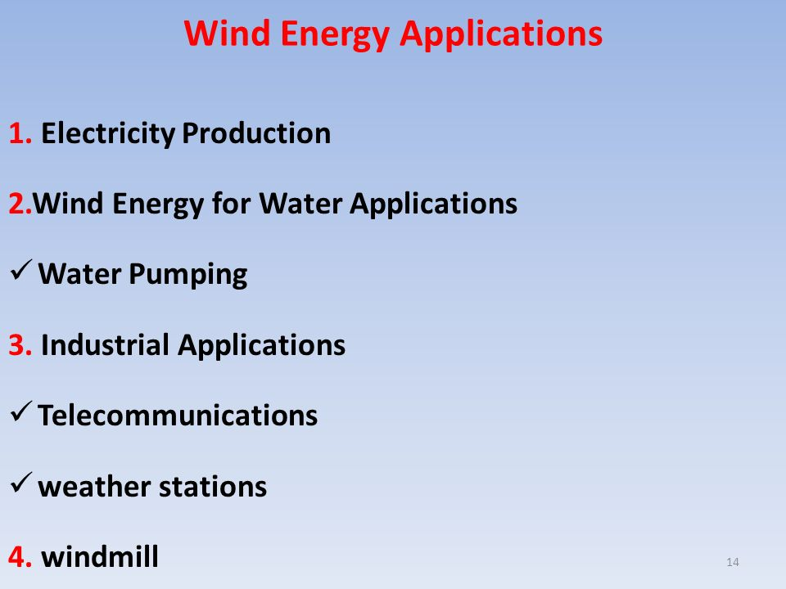
Site selection requirements: Applications of Wind Energy:
Altitude of the proposed site i. Electricity applications
Local ecology ii. Pumping applications
Distance to roads or railways iii. Direct heat applications
Nearness of site to local centre or users
Nature of ground
Favourable land cost
Advantages of wind energy:
It is a renewable source.
Like all forms of solar energy, wind power system are non-polluting,
as it has no adverse influence on the environment.
Wind energy systems avoid fuel provision and transport.
On small scale upto a few kilowatt system is less costly.
Disadvantages of wind energy:
Wind energy is available in dilute and fluctuating in nature.
Unlike water energy wind energy needs storage capacity because of its irregularity.
Wind energy systems are noisy in operation.
Wind power systems have a relatively high overall weight.
Large areas are needed, propellors 1 to 3 m in diameter deliver power in the 30 to 300W range.

Slide 19
Unit-IV
Part-B
Bio-mass
Principles of bio-conversion
Anaerobic
Aerobic digestion,
Types of bio-gas digesters
Gas yield
Gasifiers
Applications

Slide 20
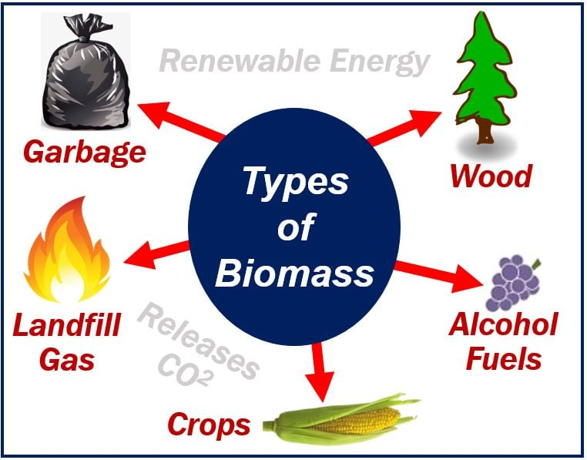

Introduction to bio-energy:
Bioenergy is renewable energy created from natural biological sources.
Many natural sources, such as plants, animals, and their by-products can be valuable resources.
Bio-energy available in the following forms those are:
Bio-mass
Bio-gas
Bio-fuel

Slide 21
Biomass energy:
Biomass is organic or carbon-based material that can either react with oxygen for combustion or undergo metabolic process to release heat.
Biomass can be used as such in its original form.
Biomass is mainly in the form of wood and it is the source of energy.
Biomass is used both in domestic and in industrial activities by way of direct combustion.
Biomass accounts for about 15% of the energy used in the world.
Biomass energy sources and biomass wastes:
The biomass resources include organic materials obtainable from forest, agriculture residues, energy crops, urban waste, aquatic plants from industrial and social activities.
Forests:
Forests (natural or cultivated) are source of fuel wood, charcoal and producer gas.
Agriculture residues:
Straw, rice husk, groundnut shell, coconut shell and sugarcane bagasse are crop residues which are the main biomass resources.

Slide 22
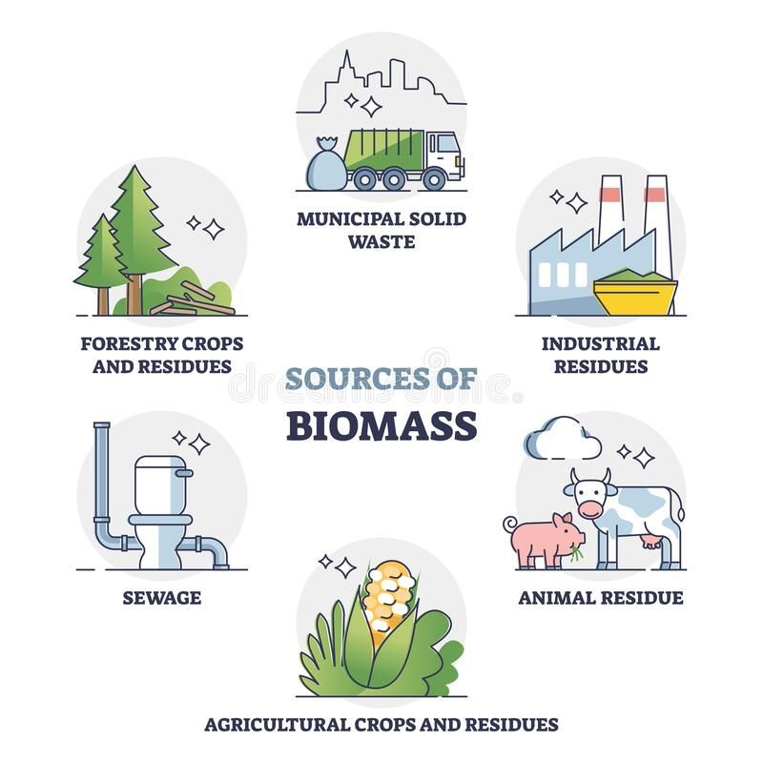
Energy crops:
Energy crops are those cultivations which provide raw materials for biofuels.
Ex: Sugar plants
Urban waste:
Urban waste can be garbage or municipal solid waste (MSW) and sewage or liquid waste.
Aquatic plants:
Certain aquatic or water plants are capable of growing extremely fast and supply organic raw materials for producing biogas.
The fast-growing water plants include water hyacinth, seaweed, algae and kelp.

Slide 23
Principles of biochemical conversion or bio-conversion:
Biochemical conversion is the decomposition of biomass into liquid and gaseous fuel using metabolic action of micro-organisms like bacterial, yeast etc.
Biochemical conversion is divided into tow types:
Aerobic bio conversion
Anaerobic bioconversion
Aerobic bio-conversion processes:
The literary meaning of aerobic is any process taking place in the presence of air.
Biogas technology is concerned with micro-organisms.
There are different types of micro-organisms like bacteria, fungi, virus etc.
Bacteria grows in presence of oxygen are called aerobic.
Aerobic fermentation can be used to decompose organic matter.
Normally aerobic digestion produces CO₂, NH₃ and small amounts of other gases along with a decomposed mass and evolution of heat.
Anaerobic bio-conversion process:
The literary meaning of anaerobic is any process taking place in the absence of air or oxygen.
It involves in the microbial digestion of biomass.
The anaerobic digestion or fermentation in biomass slurry is started by a microorganism called anaerobe.
Anaerobic bacteria also called as methane formers.

Slide 24
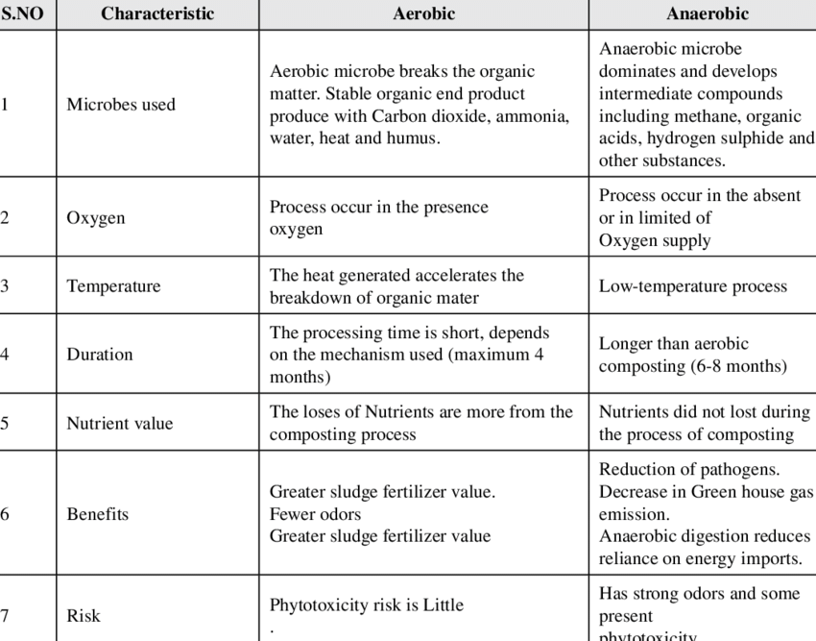
Differences between aerobic and anaerobic digestion processes:
Table: Differences between aerobic and anaerobic digestion processes

Slide 25
Bio-gas plant technology:
or
Biomass conversion (or) procedure:
A physical structure designed to carry out anaerobic digestion of organic materials is called biogas plant.
There are basic technologies or procedures to convert the biomass into direct energy or more valuable or convenient products.
Components of biogas plants:
Mixing tank:
Cow dung is collected from the shed and mixed with the water in equal proportion (1:1) to make a homogenous mixture (slurry) in the mixing tank.
ii. Feed inlet pipe/tank:
The homogenous slurry is let into the digester through this inlet pipe.

Slide 26
iii. Digester:
The fed slurry is subjected to anaerobic fermentation with the help of microorganisms inside the digester.
iv. Gas holder:
As a result of anaerobic fermentation, gas produced is stored in gas holder.
v. Gas outlet pipe:
Stored gas is released and conveyed through the gas outlet pipe present at the top of gas holder.
vi. Digested slurry (sludge) outlet tank/pipe:
The digested slurry is let out from the digester through slurry outlet pipe.
Classification of biogas plants:
Biogas plants can be classified as batch type and continuous type.
The continuous type biogas plants can be further classified as
Floating drum or constant pressure type plant
Fixed dome or constant volume type plant

Slide 27
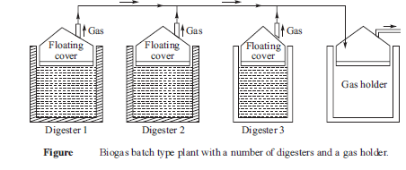
Batch type plant:
A batch type plant consists of a number of digesters which are charged, used and emptied one by one in a synchronous manner to maintain regular supply to gas holder or storage tank.
Each digester is charged with fresh biomass and it starts supplying biogas after 8–l0 days.
The digester is now capable of supplying biogas for about 40–50 days till its biomass is completely digested.
Afterwards, this digester is emptied and recharged with fresh biomass.
Hence, each digester should be charged in about at the interval of 50–60 days.
Digesters in a batch biogas plant is shown in the figure.
The installation and operation of batch type plant is both capital and labour intensive.

Slide 28
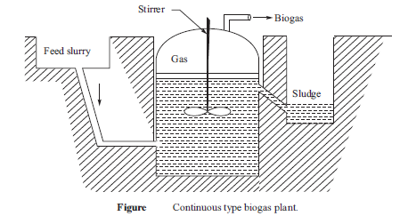
Continuous type biogas plant:
In continuous type biogas plant, a certain quantity of biomass slurry is fed daily into the digester.
This is made possible by the removal of digested slurry through an outlet so that the digester can have space to intake fresh biomass slurry.
The biogas produced is either stored in the digester or removed to be stored in a gas holder.
The plant operates continuously and it is stopped only for the removal of sludge.

Slide 29
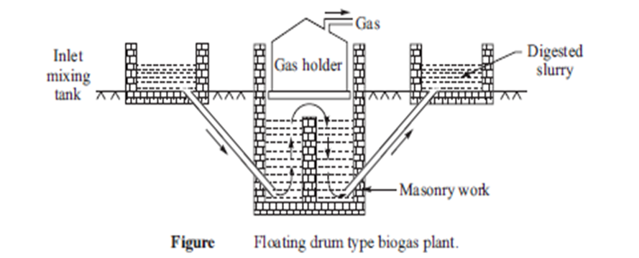
Floating drum type biogas plant:
The plant consists of an inverted metallic drum to function as gas holder and an underground digester constructed from masonry with a partition wall as shown in figure.
The digester chamber is provided with a partition wall at the centre so that optimum conditions for growth of acid forming bacteria and methane forming bacteria can be provided in the partitioned portions as biomass slurry should be acidic and basic for acid forming and methane forming bacteria, respectively.
The pipe arrangements are provided to the digester for the supply of fresh feed of biomass slurry and the removal of digested slurry.
As the digester has floating gas holder, the pressure inside the digester remains constant.
There is no risk of explosion due to prevailing low pressure of gas.

Slide 30
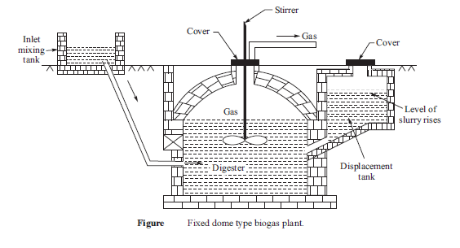
Fixed dome type biogas plant:
It has constant volume but varying pressure inside the digester as it has no movable type gas holder but a fixed dome at the upper portion of the digester as shown in figure.
The biomass and water are mixed into slurry in inlet mixing tank, which is fed into the digester through the inlet pipe.
A stirrer is provided in the digester tank to mix the slurry inside the digester, which also helps in mixing of scum floating on the slurry.
The generated biogas accumulates in the fixed dome of the digester and it is taken out by an outlet pipe.
The residual digested slurry is taken out from an opening in the digester.

Slide 31
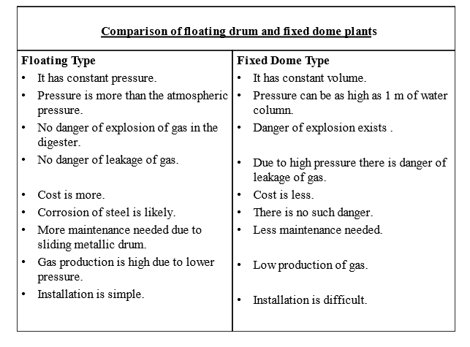
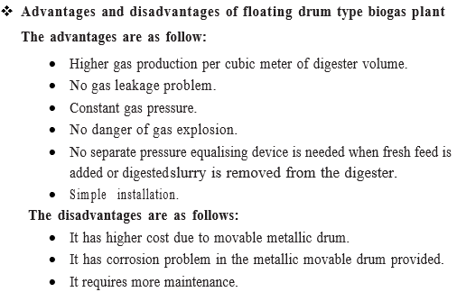
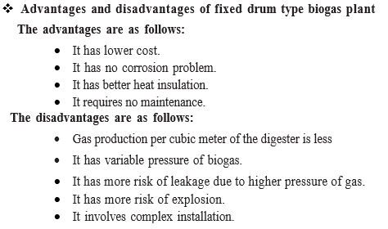
Comparison between floating drum and fixed dome plants:

Slide 32
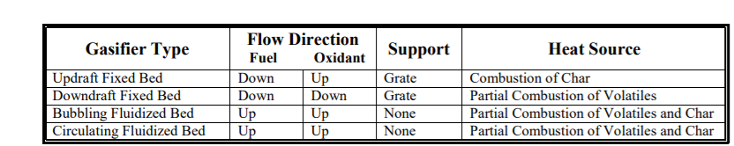
Biomass gasification or gasifiers:
Biomass gasification is used to convert solid biomass such as wood and its waste or agriculture waste into a combustible gas mixture of carbon monoxide and hydrogen.
This combustible gas mixture is called producer gas.
It has been reported that producer gas can be used to replace up to 75% diesel in a diesel engine.
The gasifiers can be classified into:
Fixed bed
Updraft gasifier or Counter current gasifier
Down draft gasifier or Co- current gasifier
Cross draft gasifier Table: Classification of gasifiers
Fluidized bed gasifier
Circulating fluidized bed gasifier
Bubbling fluidized bed gasifier

Slide 33
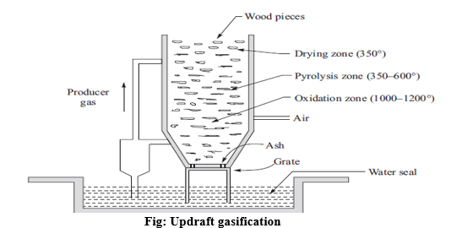
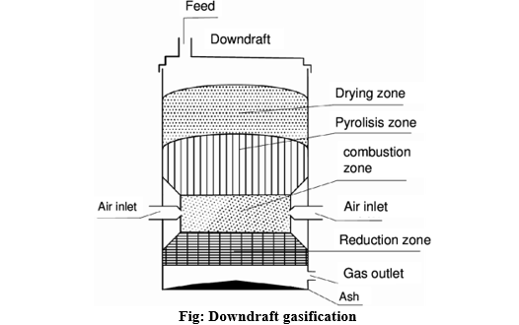
Updraft gasification:
Updraft gasification also known as counterflow gasification, the updraft configuration is the oldest and simplest form of gasifier; it is still used for coal gasification.
Biomass is introduced at the top of the reactor, and a grate at the bottom of the reactor supports the reacting bed.
Air or oxygen and/or steam are introduced below the grate and diffuse up through the bed of biomass and char.
Downdraft gasification:
Downdraft gasification also known as cocurrent-flow gasification, the downdraft gasifier has the same mechanical configuration as the updraft gasifier except that the oxidant and product gases flow down the reactor, in the same direction as the biomass.
A major difference is that this process can combust up to 99.9% of the tars formed.

Slide 34
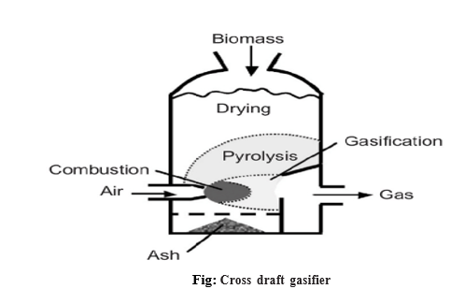
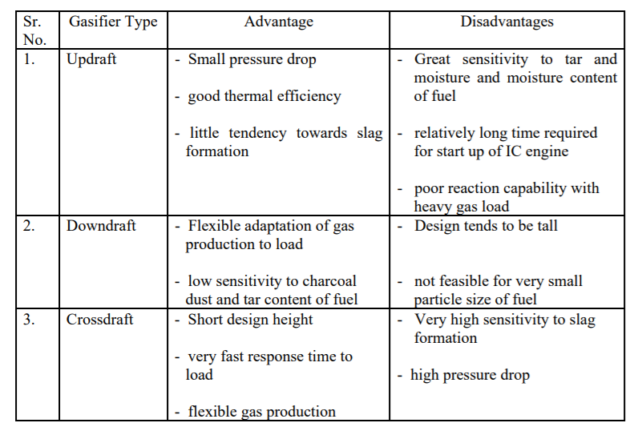
Cross draft gasifier:
A cross draft-type gasifier is shown in figure.
Air enters the gasifier through a water-cooled nozzle mounted on one side of the firebox.
It operates at a very high temperature and confines its combustion and reduction zone near the air nozzle.
Because of short path length for gasification reactions, this type of gas producer responds most rapidly for change in gas production.
The high exit temperature of the gas and low CO₂ reduction results in poor quality of gas and low efficiency.
Table: Advantages and disadvantages of fixed bed gasifiers

Slide 35
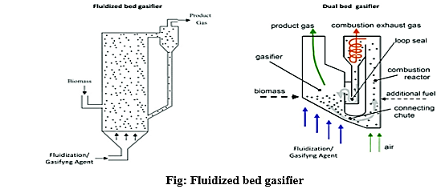
Fluidized bed gasifier:
A fluidized bed gasifier takes the advantage of excellent mixing characteristics and high reaction rates of gas-solid mixture.
A simple fluidized bed gasifier is a chamber with a bed of inert particles such as sand or limestone supported by a distributor plate as shown in figure.
The fluidized bed is initially heated externally close to the operating temperature.
The fluidized bed design produces a gas with low tar content but high value of particulate.

Slide 36
Applications of gasifier:
Heat production
Electricity production
Hydrogen production
Fuel gas production
Bio-energy production
Sawmills, wood cutting industries, and in generating power
Pulp industries
Cement industries
Metallurgy
Lime industries

Slide 37
Descriptive questions
What is the basic principle of wind energy conversion and classify the wind turbines?
Derive the expression for power developed due to wind by using Betz model.
Define:
i. Power coefficient ii. Torque coefficient iii. Thrust coefficient iv. Lift machines v. Drag machines vi. Matching
Illustrate the working of HAWT.
Discuss in detail the working of VAWT.
Write differences between HAWT and VAWT?
Compare aerobic and anaerobic bio-conversion processes
Classify and explain the biogas plants
Explain different types of biomass gasifiers
Differentiate floating drum and fixed dome plants.
Short answer questions
Define wind energy.
Write the equation for energy available in the wind.
List out the characteristics of wind?
Define bioenergy.
List out the applications of gasifier.
Assignment questions
Describe various types of winds,
Illustrate wind data measurement by using different devices.
Calculate the gas yield content from the biomass.
Demonstrate the transesterification process with neat sketch.

